Slide 1
Hackathon 2023
“AIML Based Ticket Prediction Model”
Future Prediction was never that easy!!!
Theme : Operational Improvements Design with Measurable Benefit
Team Members:
Gourav Jain
Mahendra Chavan
Alok Ranjan

Slide 2
Predicting Incoming Defects/Tickets
Current - Manual Ticket Prediction Model
How we do Manual Prediction of incoming Tickets/Defects- General Approach
Pull last 6-1 yrs data in excel for their respective project
Check the past trend of ticket/defects data based on various categories
External
Internal
Componentwise
Put some assumption based on past trend and based on the experience of Managers/PMO’s build model in excel
Major upcoming release
Migration
Increase onboarding traffic
Special events
Etc.
Limitation of Manual prediction
Time consuming- always we need to carefully add data frequently
Project specific – bases on project expertise and Knowledge
High dependency- on specific roles, PMO’s, Managers

Slide 3
Predicting Incoming Defects/Tickets
The AI/ML-Based Ticket Prediction system is designed to leverage the power of Artificial Intelligence and Machine Learning. It will utilize historical data collected from Jir Ticket system((TMS)) to understand patterns and trends in ticket inflow over time. Using this information, the system will develop accurate predictions for the future volume of incoming tickets
Ticketing systems
Test
Data
TMS
Ticketing systems interface can be done with API
Model
Training &
Building
GTS
Data
Acquisition
Data
Cleaning
Model
Testing
Model
Deployment
For Hackathon POC we extracted csv from Ticketing systems to pass to AI ML Model
NCSS

Slide 4
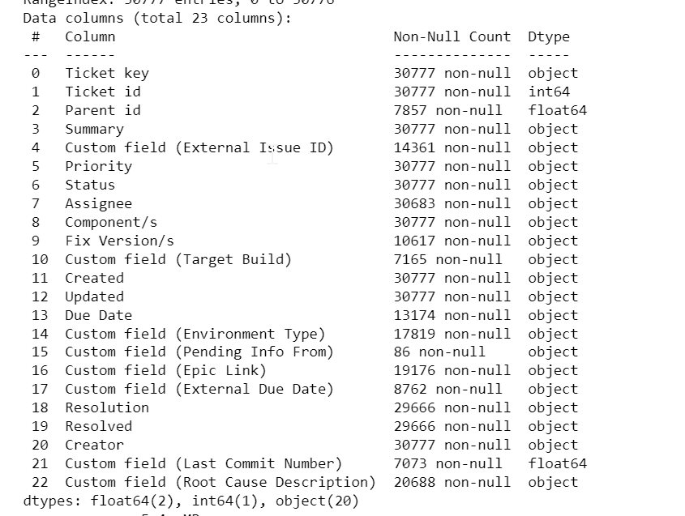
Predicting Incoming Defects/Tickets
The AI/ML-Based Ticket Prediction system is designed to leverage the power of Artificial Intelligence and Machine Learning. It will utilize historical data collected from Jir Ticket system((TMS)) to understand patterns and trends in ticket inflow over time. Using this information, the system will develop accurate predictions for the future volume of incoming tickets
Ticketing systems
Test
Data
TMS
Checking relevant Features set in data and their relationship and remove data which is not needed
Model
Training &
Building
GTS
Data
Acquisition
Data
Cleaning
Model
Testing
Model
Deployment
NCSS

Slide 5
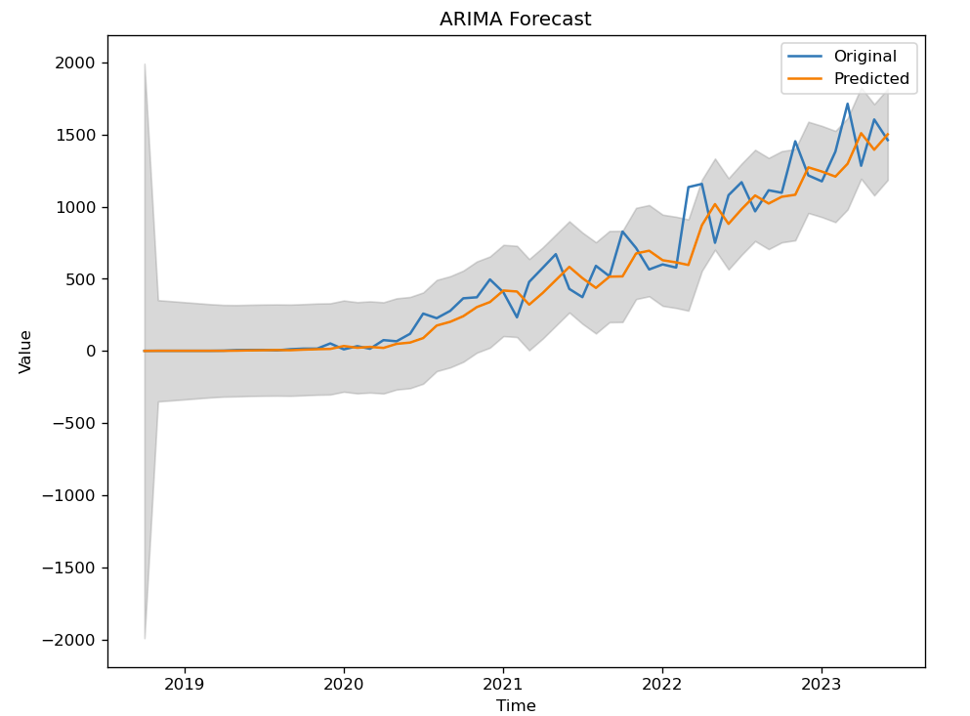
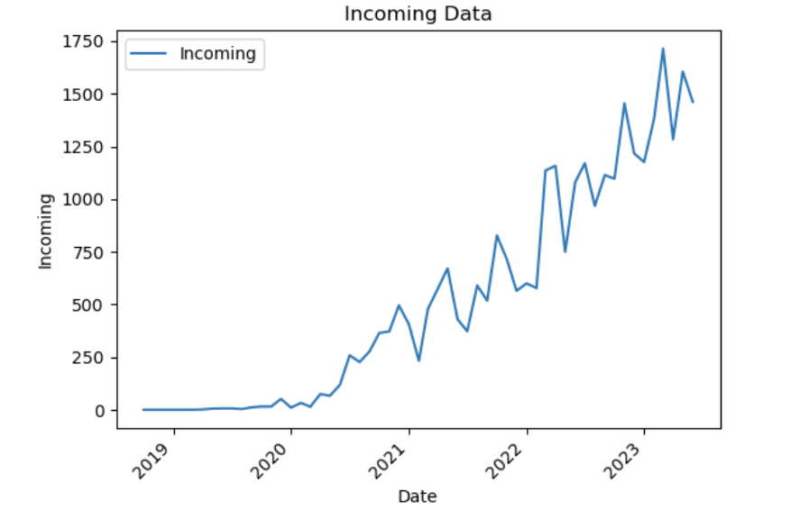
Predicting Incoming Defects/Tickets
The AI/ML-Based Ticket Prediction system is designed to leverage the power of Artificial Intelligence and Machine Learning. It will utilize historical data collected from Jir Ticket system((TMS)) to understand patterns and trends in ticket inflow over time. Using this information, the system will develop accurate predictions for the future volume of incoming tickets
Ticketing systems
Test
Data
TMS
Model
Training &
Building
GTS
Data
Acquisition
Data
Cleaning
Model
Testing
Model
Deployment
NCSS
Training ML model – Time series ARIMA with our historical data and checking how it predicts of data
Autoregressive Integrated Moving Average (ARIMA): A classic Machine Learnig model that combines autoregression, differencing, and moving average components.

Slide 6
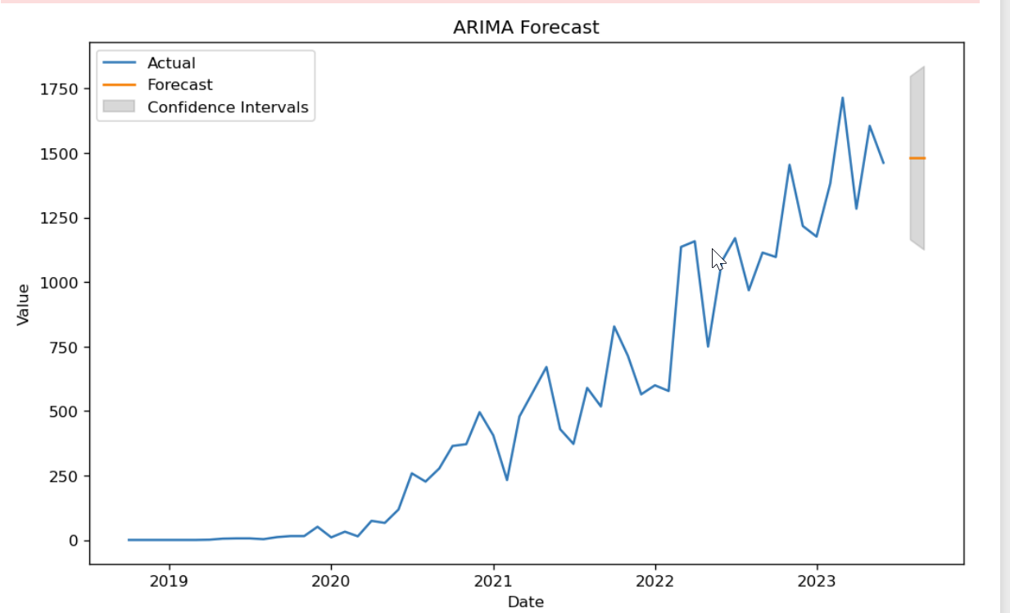
Predicting Incoming Defects/Tickets
The AI/ML-Based Ticket Prediction system is designed to leverage the power of Artificial Intelligence and Machine Learning. It will utilize historical data collected from Jir Ticket system((TMS)) to understand patterns and trends in ticket inflow over time. Using this information, the system will develop accurate predictions for the future volume of incoming tickets
Ticketing systems
Test
Data
TMS
Model
Training &
Building
GTS
Data
Acquisition
Data
Cleaning
Model
Testing
Model
Deployment
NCSS
Check how ML model – ARIMA predicts of data

Slide 7
Idea/Hack Utilization or Benefits
Standardization of Prediction model across project
Improved Planning: The AI/ML-Based Ticket Prediction system empowers team leads/Managers/PMO to foresee future ticket volumes, enabling better workforce planning and distribution of tasks.
Efficient Resource Allocation: With accurate predictions, managers can allocate resources optimally, ensuring that the team is adequately prepared to handle the expected ticket inflow.
Enhanced Productivity: By avoiding sudden spikes in ticket volumes, teams can maintain consistent productivity levels without compromising on service quality.
Cost Savings: Effective budget management based on ticket volume predictions can lead to cost savings and better financial decision-making.

Slide 8
Resources to be used for this Idea :
NetCracker TMS/GTS/NCSS - Ticketing system
Quick approval to have API access to NetCracker TMS - Ticketing system

Slide 9
Q & A

Slide 10


